Slide 1

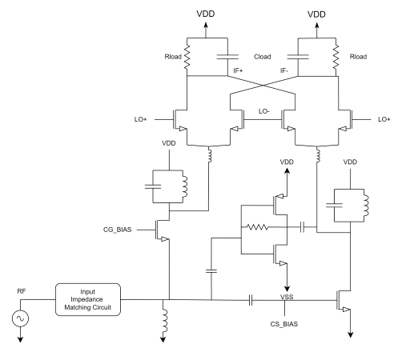
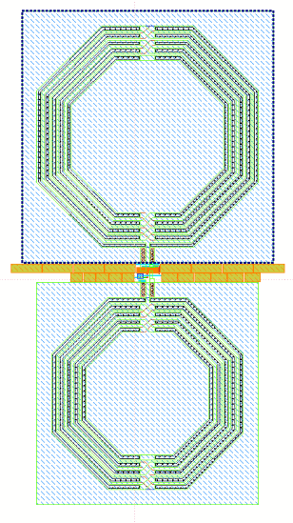
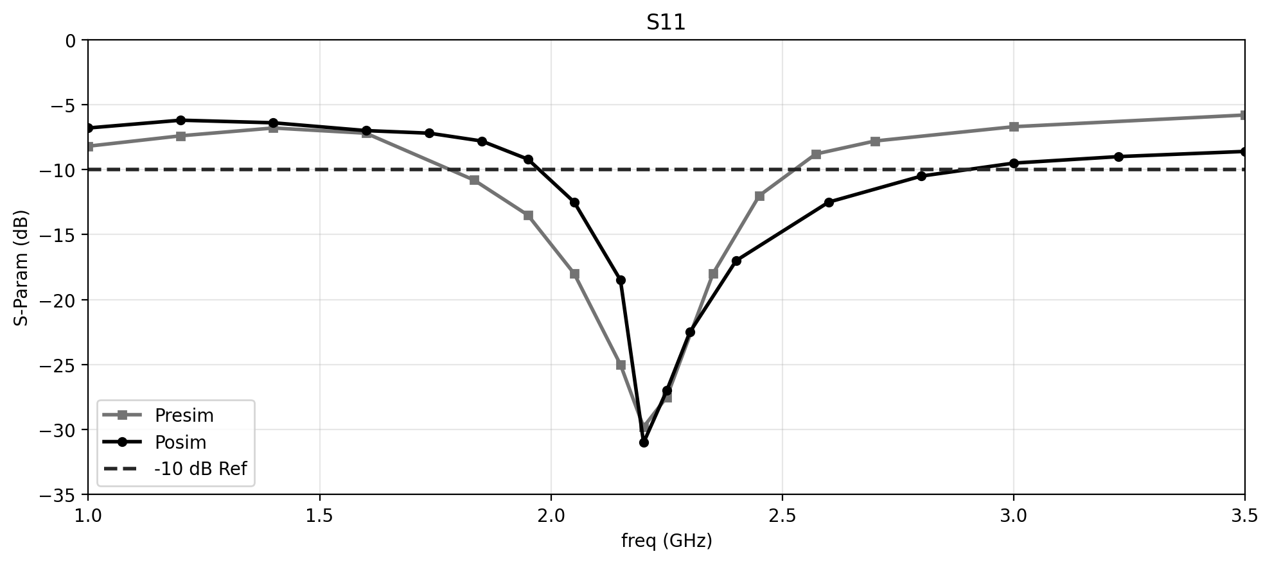
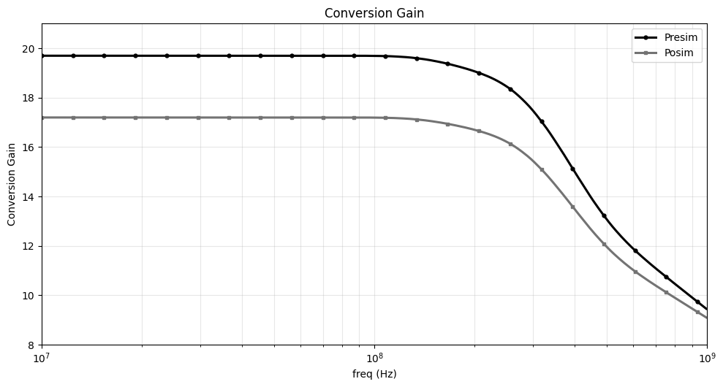
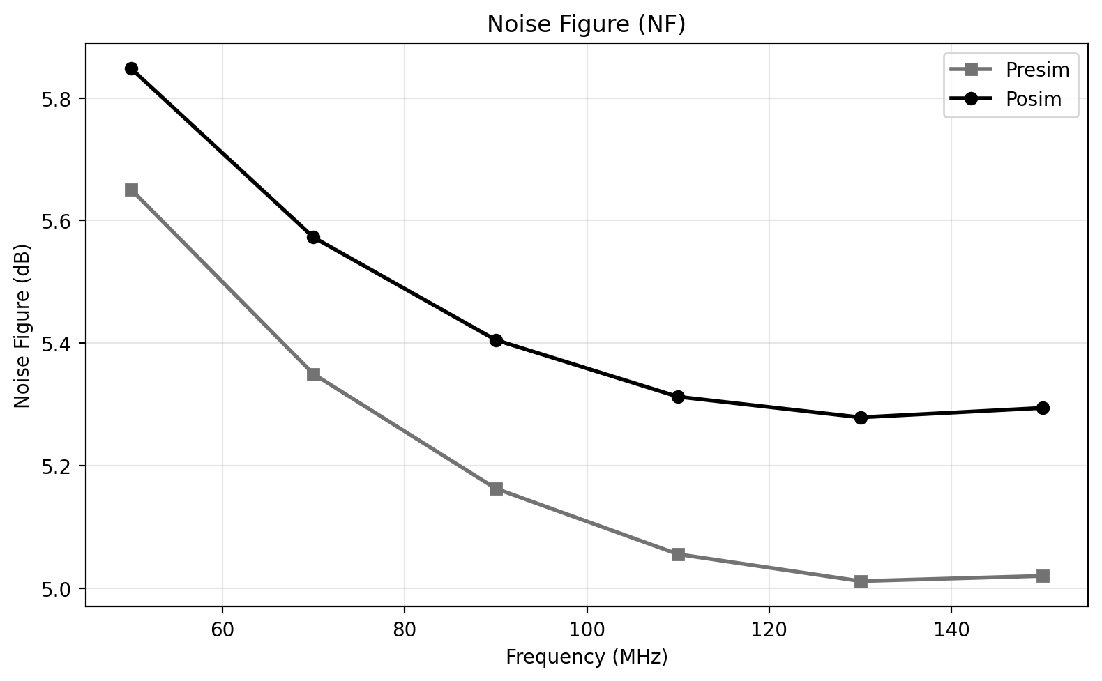
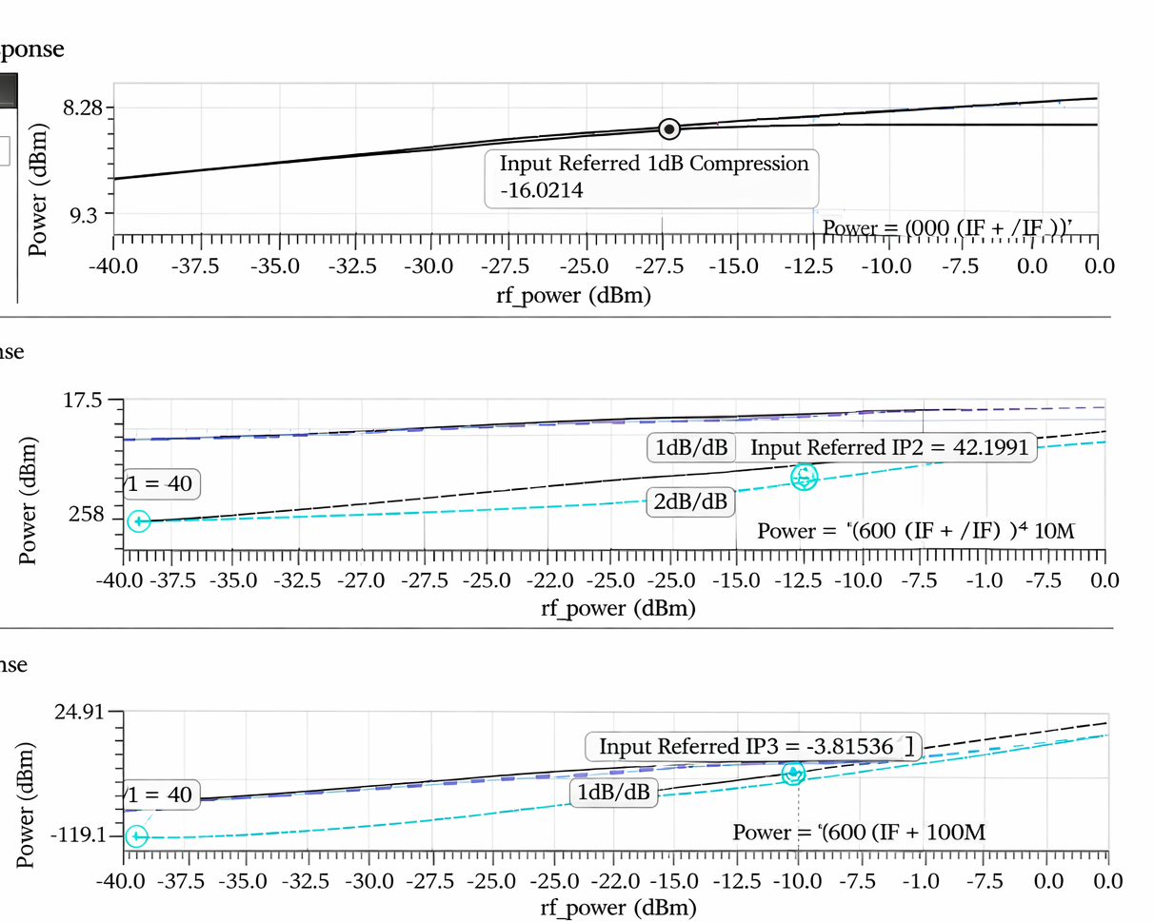
2026 IDEC Congress CDC
Noise Cancelling LNA for a 2.4GHz low noise Receiver Front end using
Peaking Inductor Based Active Mixer
SeongYoung Woo, HaJin Kim and Young Sik Kim
Department of Computer and Electronic Engineering,
Handong Global University, Pohang, Korea
1. Low Noise Amplifier (LNA)
Primary Goal : Minimal Noise Figure (NF) Maximum Sensitivity.
Gain Performance : High S21 to suppress noise from subsequent stages.
Impedance Matching : Optimized Input Matching S11 for maximum power transfer.
2. Frequency Mixer
Frequency Translation : Efficient Down-conversion from RF to IF/Baseband.
Conversion Gain : Maintaining signal strength during the mixing process.
Port Isolation : High LO-RF/LO-IF Isolationto prevent signal leakage.
3. System Integration & Linearity
Linearity : Optimized IIP3and P1dB to handle interference.
Power Efficiency : Low power consumption for mobile/IoT applications.
Input Reflection Coefficient
Circuit Full Layout
Noise Figure
 | [1] | [2] | [3] | [4] | Work(presim) | Work(posim)
Freq(GHz) | 1 - 5.5 | 0.1 - 3.85 | 2.4 | 2 - 10 | 2.4 | 2.4
Noise Figure(dB) | 3.9(avg) | 8.4 - 11.5 | 6 | 6.7 - 8.8 | 5.01 | 5.36
Conversion Gain(dB) | 17.5(power) | 12.1(power) | 21 | 17 - 20 | 19.7(power) | 17.2(power)
P1dB(dBm) | -10.5 | -12.83 | N/A | N/A | -18 | -16.02
IIP3(dBm) | 0.84 | N/A | N/A | -1 | -5.2 | -3.8
IIP2(dBm) | N/A | N/A | N/A | N/A | 38 | 42.2
S11 | <-8.8 | <-10 | <-10 | N/A | <-10 | <-10
Supply Voltage(V) | 1.5 | 1.2 | 1.8 | 1.8 | 1.2 | 1.2
Power(mW) | 34.5 | 9.8 | 1.62 | 7.2 | 10.1 | 9.2
Conversion Gain and Linearity P1dB, IIP2, IIP3
At 2.4 GHz, an input reflection coefficient S11 of -18.7 dB was recorded. A matching bandwidth of approximately 800 MHzwas secured based on the -10 dB threshold, proving the stability of the design. Furthermore, a conversion gain of 17.2 dB and a low noise figure (NF) of 5.36 dBwere achieved at the center frequency, ensuring the necessary gain and sensitivity performance for the RF front-end.

